Slide 1

Week 8
JINGYA LI

Slide 2
Outline
Exercises for Reading Skills
Academic Writing Skills
Unit 2 Quiz
Exercises for Writing Skills
Debate: Synthesizing practice

Slide 3
Fact VS. Opinion
Facts
Statements that can be proved, now (not in the future)
Opinions
Statements that show a strong personal value
E.g. ironically, amazing, fantastic, fabulous
Statements that cannot be proved now, but may be proved in the future
E.g. suggestions, predictions
Statements that show necessity
It is necessary for the interpreter to familiarize himself with what will be discussed, in order to put context into their translation.
Statements that use metaphors
…but ask popular science enthusiasts if they are aware of the dogged pursuit of the neutrino by Raymond Davis for over 13 years and you will likely see knitted brows.

Slide 4
Task 3
Key words that expressing opinions
fascinating
great, a bit of
more than any other
but probably
like nothing better than
the shorter ones do occasionally
no theorist
certainly

Slide 5
Academic Writing Skills
Reporting and Synthesizing

Slide 6
Your decision?
If you are shopping for a new computer, how do you decide which one to purchase?
You explore different sources in search of the relevant details
Customer reports
Friend reviews
Price
Features

Slide 7
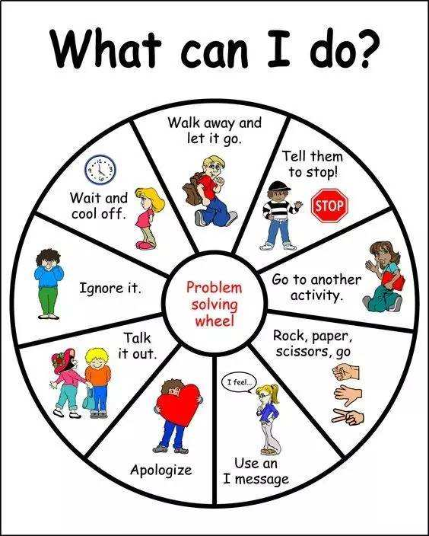


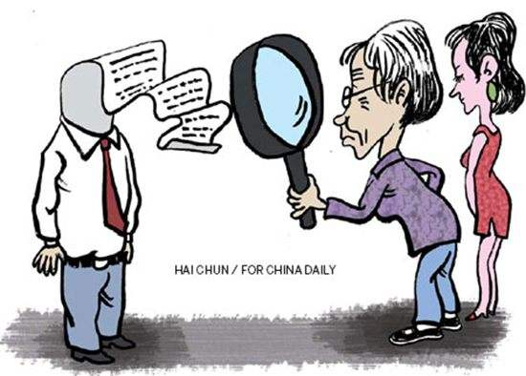


For most any decision, you do the same thing. These are all the factors that go into decision making. The final result may not always be an essay, but you are joining a conversation that is already ongoing about your topic.

Slide 8


Synthesizing
Putting pieces together!
“Synthesis is about organizing the different pieces to create a beautiful mosaic, a meaning, a beauty, greater than the sum of each shiny pieces.”
--Ellin Keene

Slide 9
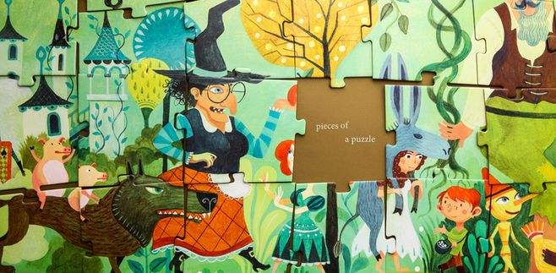
“Synthesis is a matter of seeing
how the details fit together to draw a conclusion,
how the details solve the mystery
or how they bring characters (or readers) to a new understanding.
Synthesis involves an “aha” moment, when, all of a sudden, everything becomes clear.”
--Nancy Boyles

Slide 10

Or simply put,
Synthesizing is like putting the puzzle together. You have to sort out your thinking and put it in the right place.

Slide 11
What is synthesizing in academic writing?
The process of combining the ideas of two or more sources into your research paper (in the Introduction or the Literature Review section in particular)
Source 2
Source 1
Your work
Source 3
Source 4

Slide 12
Why synthesizing?
A way of understanding and reporting what other researchers have done before
A way of notifying the research gap
A way of supporting your own perspective
A way of developing your own perspective

Slide 13

Synthesizing
Incorporation
Combine two or more findings from different sources
To support your study
Conclusion
Draw a conclusion from those findings

Slide 14
Steps for synthesizing
Analyzing
Find a relevant source
Locate the useful parts in the source
Read critically to develop your own interpretations
Compare similar or different information mentioned in the source
Summarizing
Give a brief and concise summary of relevant part in each source
Notice the similarities and differences of the related sources
Integrating
Combine those sources in order to demonstrate your own perspective

Slide 15
Strategies to organize the information in the Introduction section
Climactic order
From those most distantly related to your study to hose closely related to your study
Introducing background (from general to specific)
Avoid being too general
Chronological order
According to the time when the research was conducted or the paper was published
Comparison and contrast
To show similarities or differences of the sources
Classification
According to different approaches, different solutions, different theoretical premises or frameworks, or different variables or factors

Slide 16
Task 1
Excerpt 1: Chronological order
Excerpt 2: Order of classification
Different experiments to improve gravitational waves detectors
With each classification, chronological order is used.

Slide 17
Task 2
Sample 1: order of classification, according to different approaches.
Sample 2: climactic order, from distant to close
Sample 3: chronological order
Sample 4: order of classification, according to different applications
Sample 5: a combination of order of comparison and contrast and order of classification

Slide 18
Task 3
Group 1:
The applications of computational performance through artificial neural networks or remote sensors will make advanced nuclear energy systems possible (Fernandez, 2017 and Lee, 2017). Safety issue of nuclear power system is under serious consideration again (Lee, 2017).
Group 2:
Many devices based on the nanoscale materials are already in daily use, for example in the field of optoelectronics (Wang et al., 2015) and solar cells (Zhang and Gao, 2011).

Slide 19

Unit 3 Quiz
Best Luck!

